Slide 1
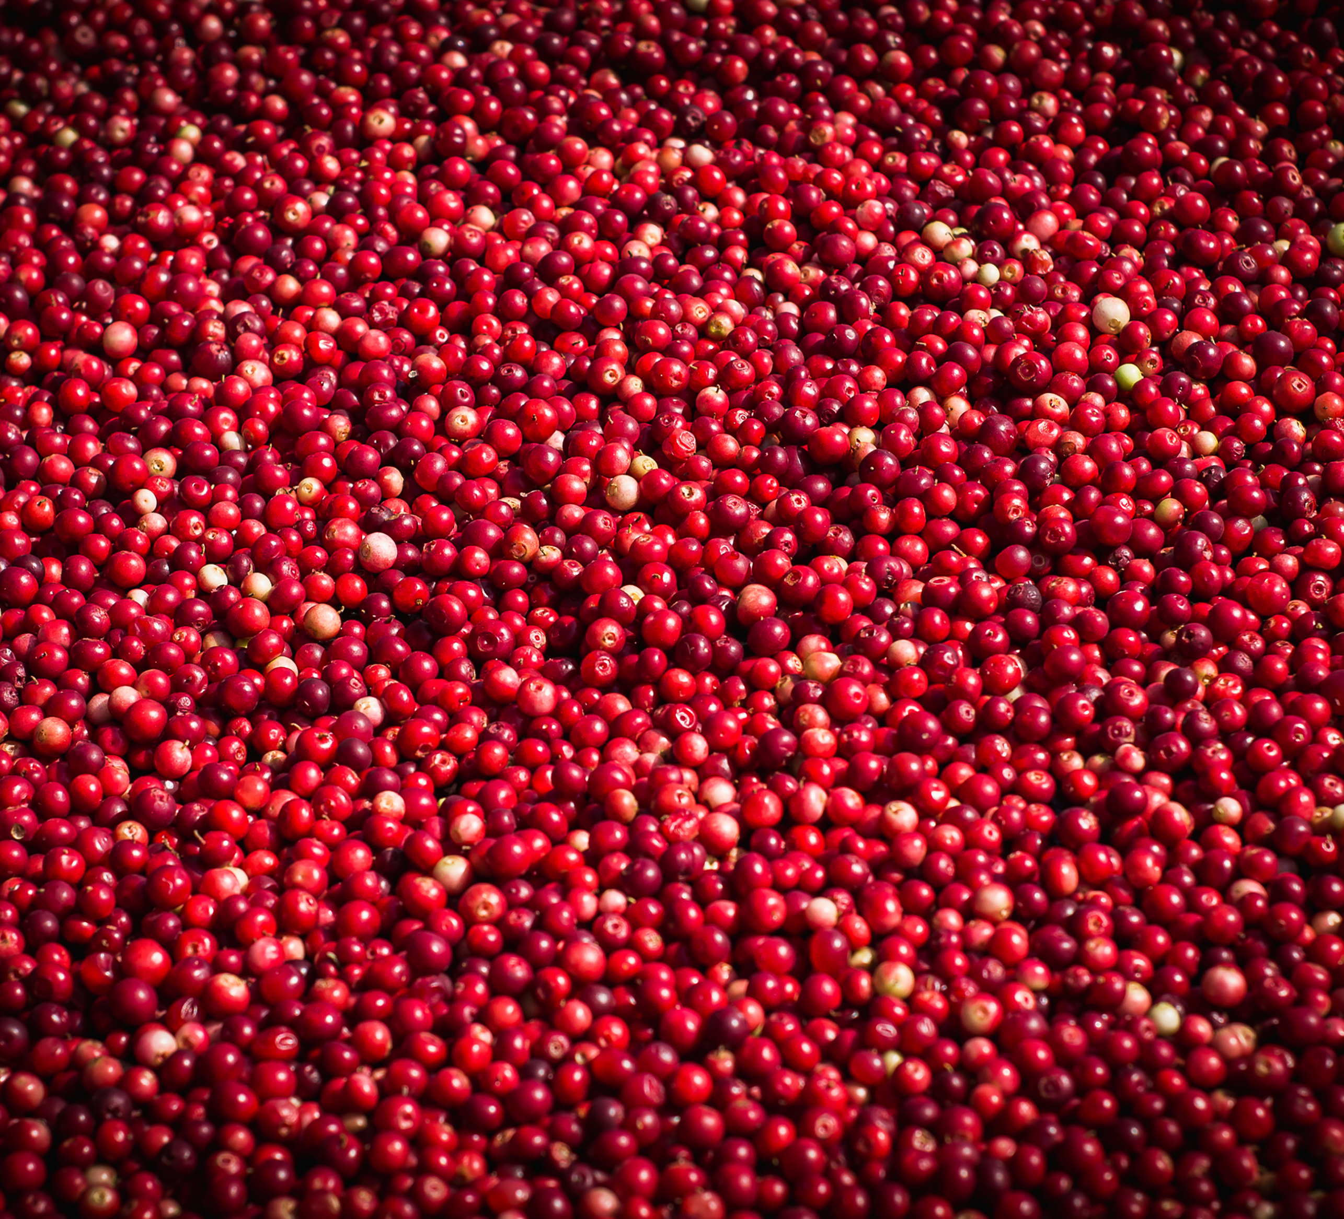
BC Cranberry Marketing Commission
2022 Annual General Meeting
March 3, 2022
Richmond, BC

Slide 2

Welcome – Agenda
Minutes of 2021 AGM
Chair’s Report – Kalpna Solanki
Board Report – Jack DeWit
Market Development Report – Coreen Rodger Berrisford
Research Report – Todd May
Financial Statements – Agatha Cluff, CPA, CA, CFP
Appointment of Auditor
Election Results – Della Oberhofner, COMB
Guest Speakers – Jennifer Dyson, Kim Grout - ALC

Slide 3
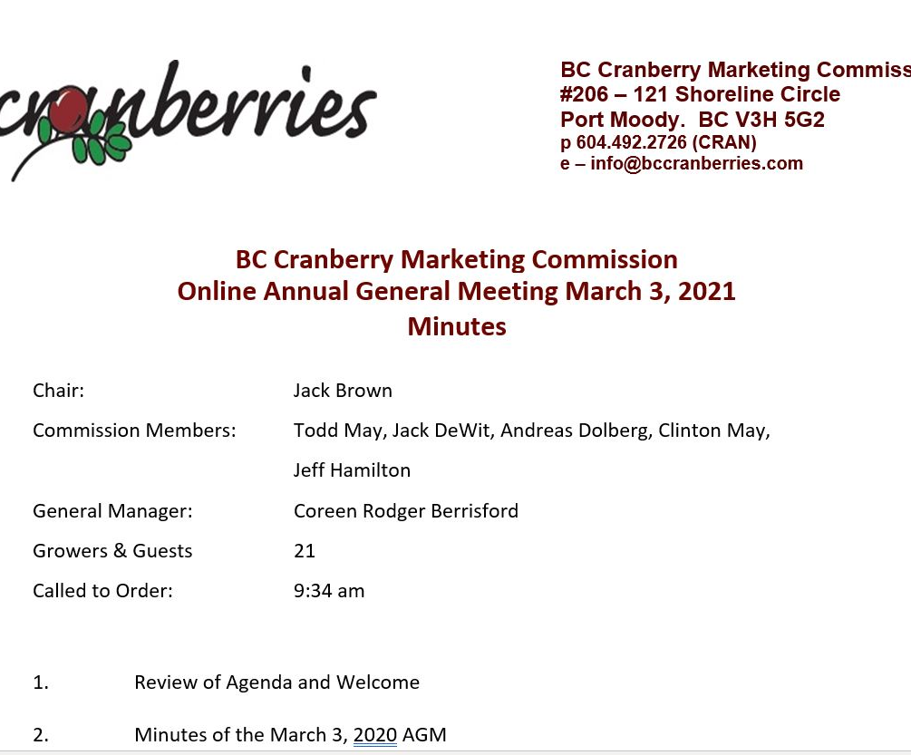
Minutes March 5, 2021 AGM
Emailed with notification of meeting
Any errors or omissions?
Motion to approve:

Slide 4

Chair Report – Kalpna Solanki
2021 Crop year
New Producer Vendor – now Grower Vendor
Updated Strategic Plan
Updated General Orders
COGA training
Cranberry Promotion –Canada wide and in BC
Pacific Northwest Cranberry Congress 2021

Slide 5
Chair Report – Cont’d
Licensed 74 Growers, 7 Producer Vendors and 3 Agencies
Working with the Growers Association and other Industry stakeholders in committees enables strong grower programs and services.
  Pacific Northwest Cranberry Congress
  Webinars – well registration, TFW
  Refreshed email communications
  Continued to support IPM bulletins
  Educational materials for teachers & children
  Statistics Canada – to reduce survey burden on fresh fruit survey
Partners/collaborators
  BC Cranberry Growers Association
  BC Cranberry Research Society
  BCAC
  BC Ministry of Agriculture
  BC Council of Marketing Boards/COGA
Good Governance
  Updated Strategic Plan
  Updated General Orders
  Code of Conduct & Conflict of Interest
  Ongoing Director and staff training
  Report to Farm Industry Review Board
  Report to Growers

Slide 6
Market Development Report
Target | Activity | Reach
Youth AITC | Spotlight Series on Cranberries Take a Bite of BC Cook-A-Long | Online broad reach 7200 students + 1060 cook along participants
Youth BC 4-H | Funding for Youth Ambassador Program | 19 youth training
General w/ BCAC | We Heart Local BC Cranberry Blog Cook-A-Long (w/ AITC) as bove | 1000 likes, 95 comments
Dieticians | Dieticians E-Newsletter Dieticians E-Blast | Over 6000 dieticians
General Social Media | Website, Facebook, Instagram, Pinterest Twitter | Increased reach in all categories

Slide 7
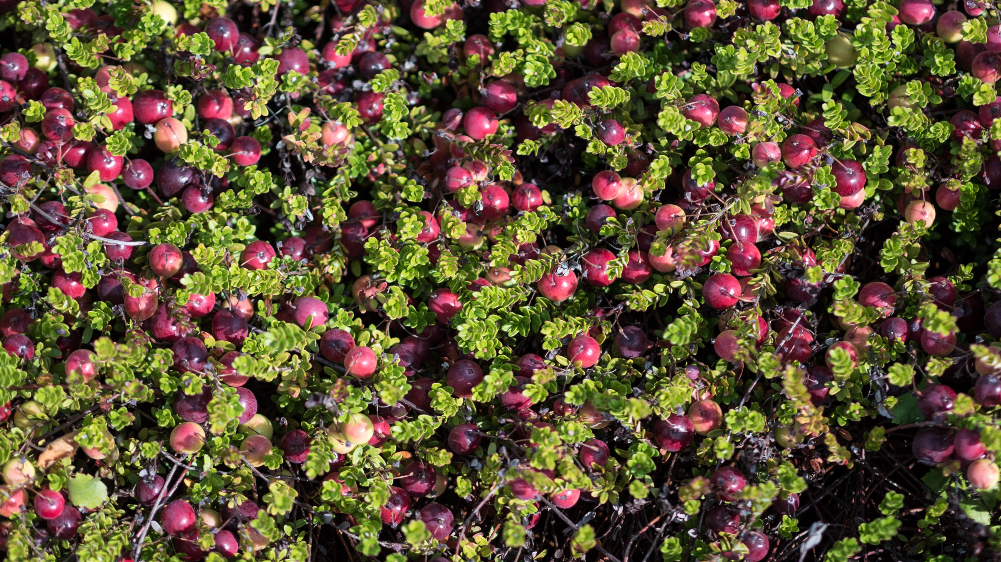
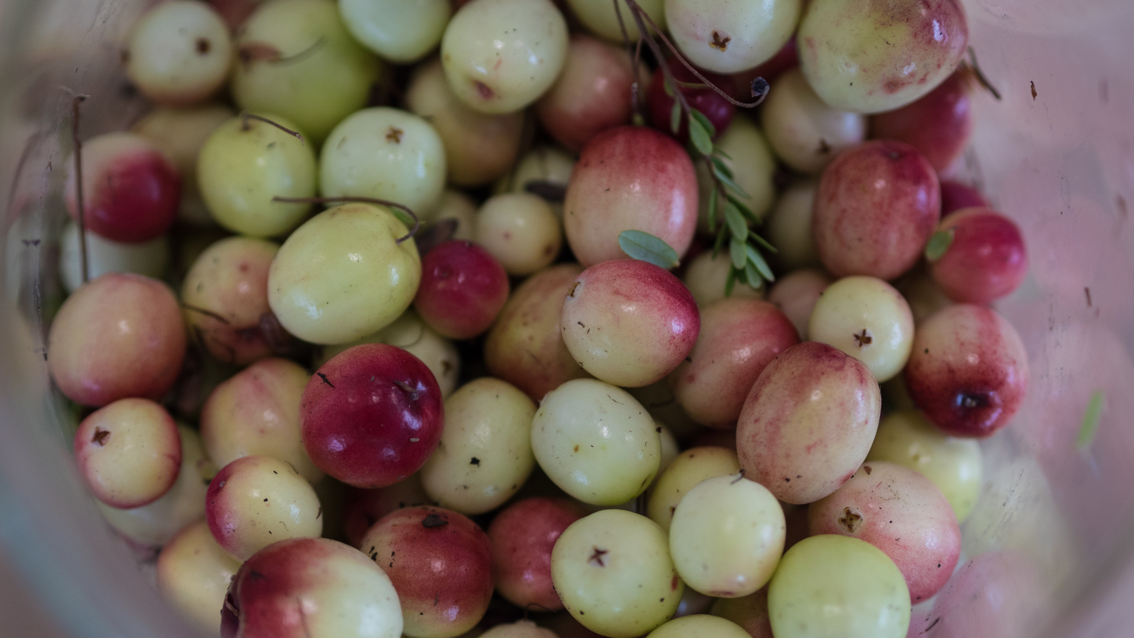
Research Report
Evaluating Varietal Performance at the Research Farm
Prohexadione Calcium for Canopy Management
Assessing an Herbicide Layering Strategy

Slide 8
Research Farm Report refer to Annual Report
Weather events – what will be the short and long term impacts?
Main research projects
  Variety Trials
  Canopy Management w/ growth regulations w/AAFC
  Weed Management w/ AAFC
Management Team
  Dr Kim Patten
  Dr Renee Prasad & students (UFV)
  E.S. Crop Consult
  Kyle Botkin – Farm Manager
Other Research on site (examples)
  Pesticide/residues and pest management
  Pest life cycle surveillance
  Water Monitoring and Mapping
  Growth Regulators
  Canopy Health
2021 crop was close to 2020
  production at 1902 barrels
  % poor averaged at 1.02%
  771 avg firmness
  Class 1 colour average was 1.09%
  91.2% greater than ½”

Slide 9
FINANCIAL STATEMENTS
PRESENTED BY:
AGATHA CLUFF, CPA, CA, CFP
Chartered Professional Accountant

Slide 10

Appoinment of Auditor
Motion Required

Slide 11
2022 Election Results Della Oberhoffner, Council of Marketing Boards, IEO

Slide 12
Agricultural Land Commission
PRESENTED BY:
Jennifer Dyson, Chair
Kim Grout, Executive Director

